Slide 1
High Poverty Stricken School Prediction
Christopher Metzler
Shehani De Silva
Deverell
Malachi Buchheit
Bailey Trip

Slide 2
Objectives
The overall objective is to design and evaluate prediction of high poverty stricken schools from the publicly available data across the U.S.
Evaluate the value of Title 1 school designation.

Slide 3
Data Gathering
No Child Left Behind
Fiscal data not out yet
2015
(ESSA passed)
2018

Slide 4
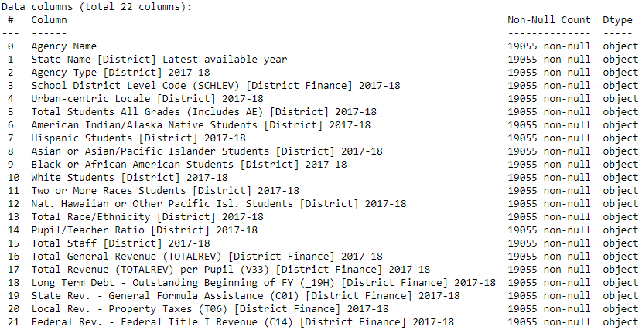
Separated the data frame into 3 smaller frames by year

Slide 5
Our data is by district, not by school.
Data does not answer the question directly
The process is identical for both types of data

Slide 6
Data Cleaning
For each data frame we filled NaN’s with 0 using pandas. print(df.isna().sum()) #Check for NA values df.fillna(value=0,inplace=True) #Drop existing NA values and replace with 0
Then we set the real value columns and categorical column labels.
We used pandas get_dummies for our categorical variables.
We also used pandas to_numeric to interpret non-numerical data. years_15_16[realcol_2015_16] = years_15_16[realcol_2015_16].apply(pd.to_numeric, errors='coerce')

Slide 7
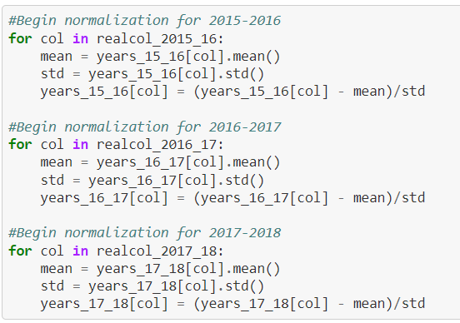
Feature Normalization
Important to bring all the features to the same scale
Used z-score normalization method
We did normalization on real value columns
(Col_value- Mean of the col)/ Standard Deviation of the col
Normalized data work better on KNN models

Slide 8
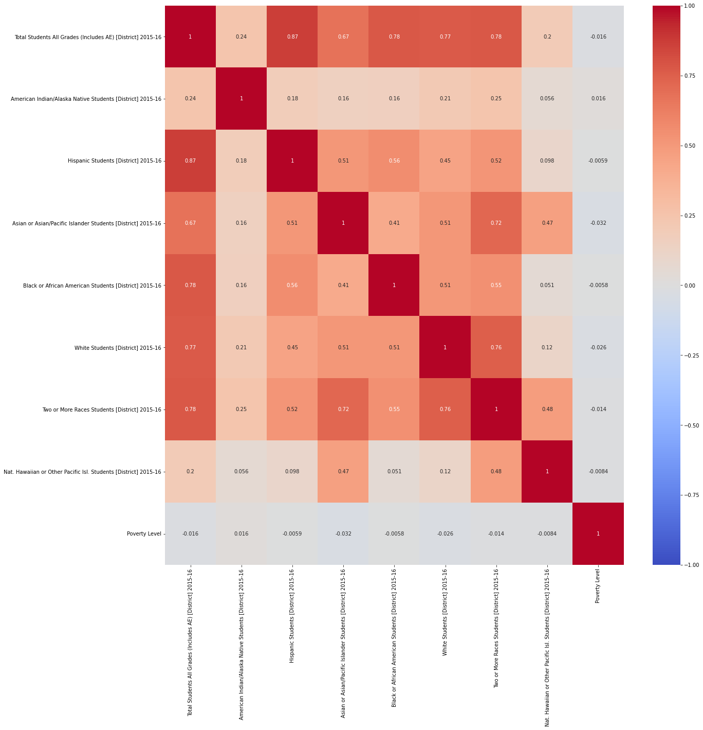
Correlation Chart
Heatmap showing the correlation values for each column and our poverty column
Pupil/Teacher ratio column is in most negative correlation
American Indian/Alaskan native students column is in most positive correlation with the poverty column.
Scatterplots showing strongest correlation to Poverty Level on next slide.

Slide 9
Thresholds for Poverty Level
Strict Poverty: Total Revenue for the District is less than $10,000
High Poverty: Total Revenue for the District is less than $15,000
No Poverty: Total Revenue for the District is greater than $15,000
Created a Poverty Level column to classify

Slide 10
Feature Selection
Pupil/Teacher Ratio [District] 2015-16 Most negative correlation
American Indian/Alaska Native Students [District] 2015-16 Most positive correlation
Remove revenue columns used in determining Poverty Level
col_remove = ['Agency Name', 'State Name [District] Latest available year']
col_remove_2017_18 = ['Total General Revenue (TOTALREV) [District Finance] 2017-18','Long Term Debt - Outstanding Beginning of FY (_19H) [District Finance] 2017-18','State Rev. - General Formula Assistance (C01) [District Finance] 2017-18', 'Local Rev. - Property Taxes (T06) [District Finance] 2017-18',
'Federal Rev. - Federal Title I Revenue (C14) [District Finance] 2017-18']
years_17_18.drop(columns=col_remove+col_remove_2017_18, inplace=True)
Repeat for subsequent years
col_remove_2016_17 = []
for col in col_remove_2017_18:
col_remove_2016_17.append(col[:-7]+"2016-17")
years_16_17.drop(columns=col_remove+col_remove_2016_17, inplace=True)

Slide 11
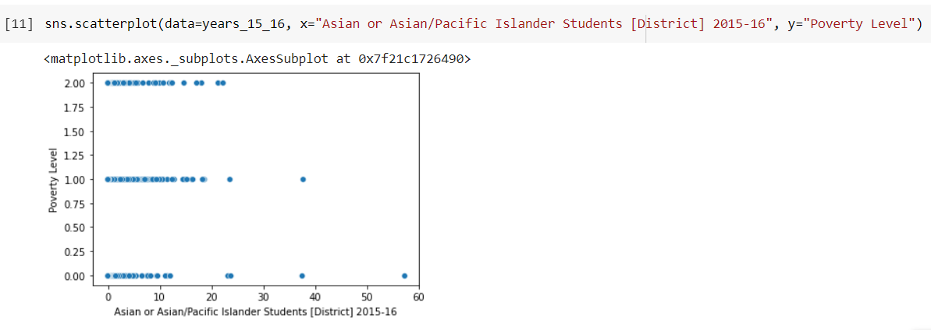
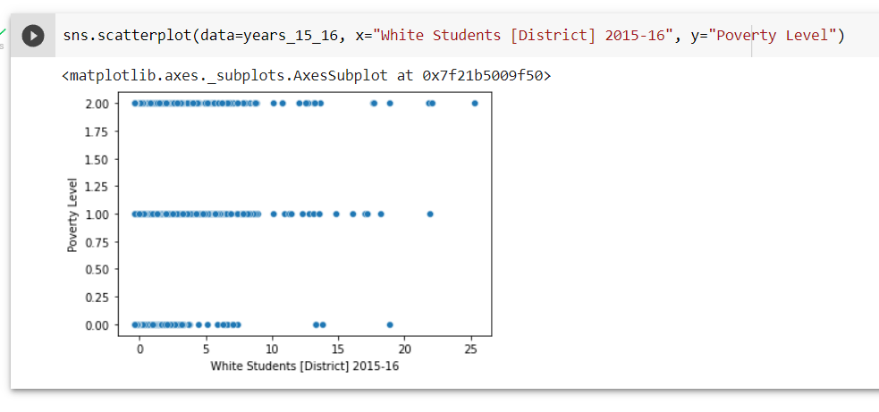

Slide 12
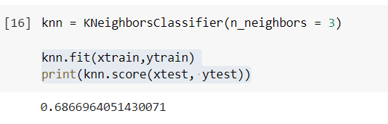
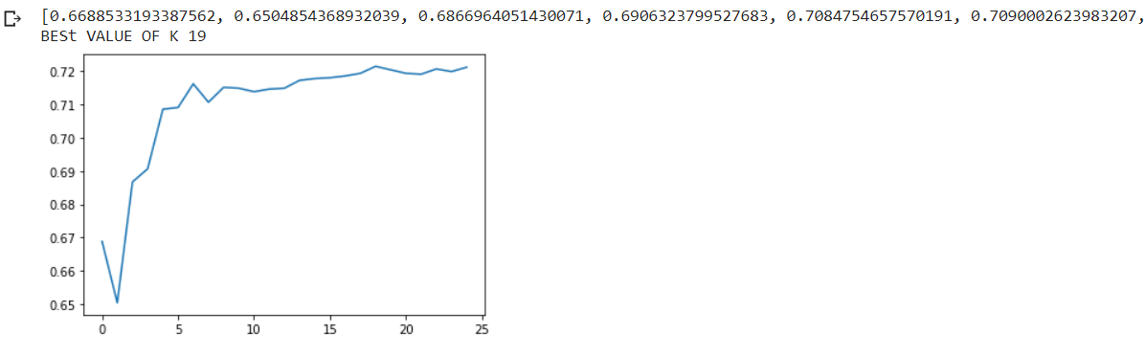
Data Modeling
We started with a knn classification model first because it is easy to implement.
We then used a return score function to find the best value of k

Slide 13
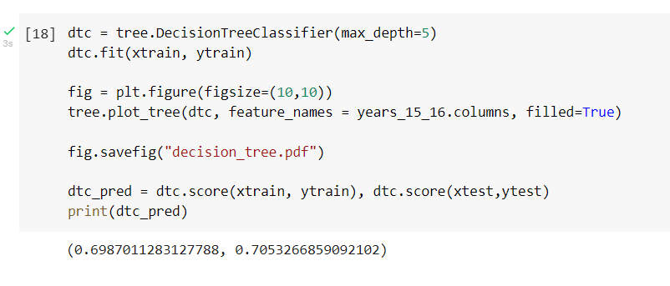
Data Modeling
We also decided to implement a decision tree model because it is easy to interpret the data.
We then used sklearn pipeline to scale the data and find optimal decision tree stopping criteria with cross fold validation. Shown on next slide:

Slide 14
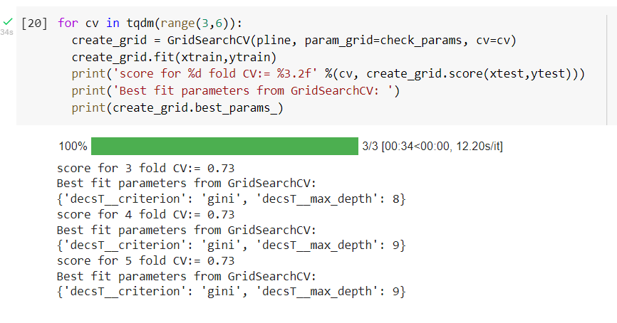
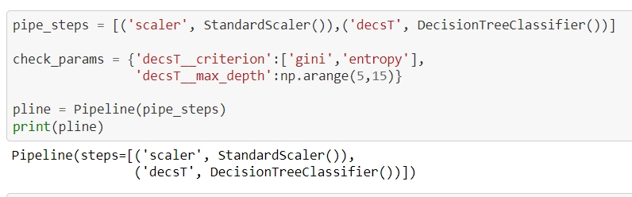
Data Modeling

Slide 15







Decision Tree
(only 1st,2nd,3rd split, Max depth = 8)

